Slide 1


INTRODUCTION

Slide 2




Slide 3




Slide 4



Slide 5



Slide 6



Slide 7
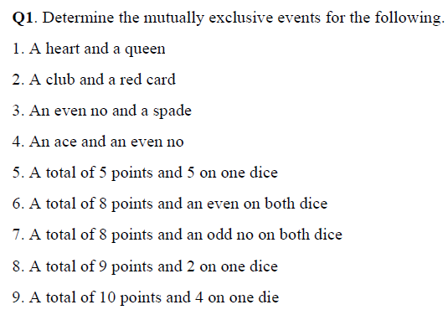
Mutually Exclusive : 2,4,8
Not Mutually Exclusive : 1,3,5,6,7,9

Slide 8
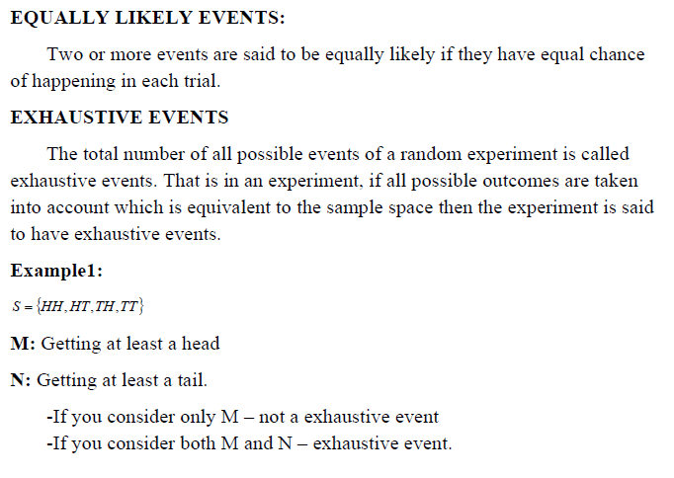

Slide 9
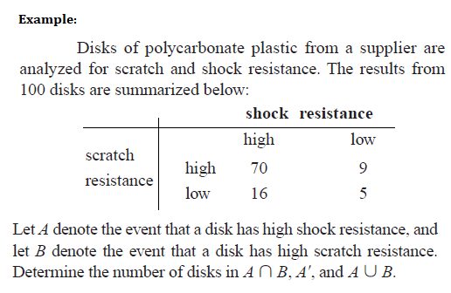
Solution:
n(A ∩ B) = 70
n (A’) = 9 + 5 = 14
n(A ∪ B) = 70 + 9 + 16 = 95

Slide 10
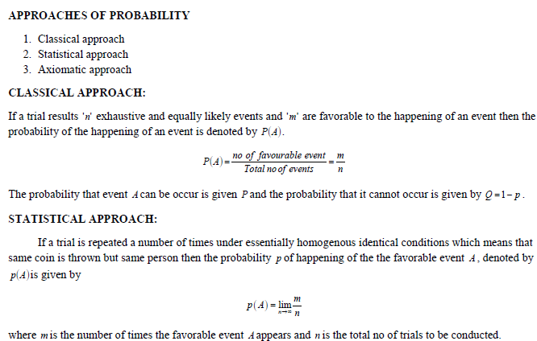

Slide 11
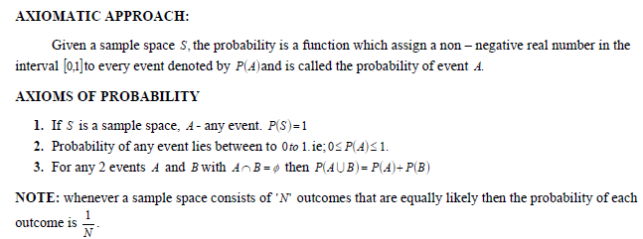

Slide 12

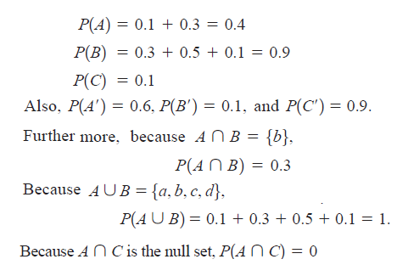

Slide 13
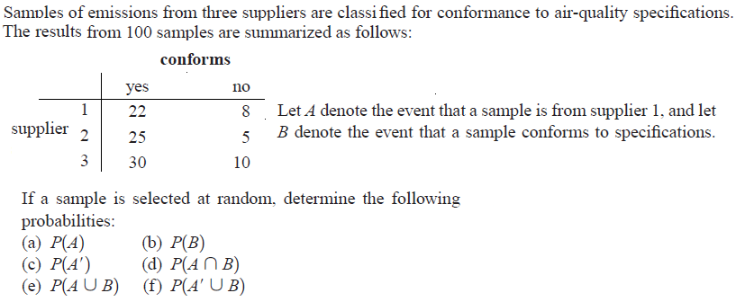

Example:2
Solution :

Slide 14
